Slide 1
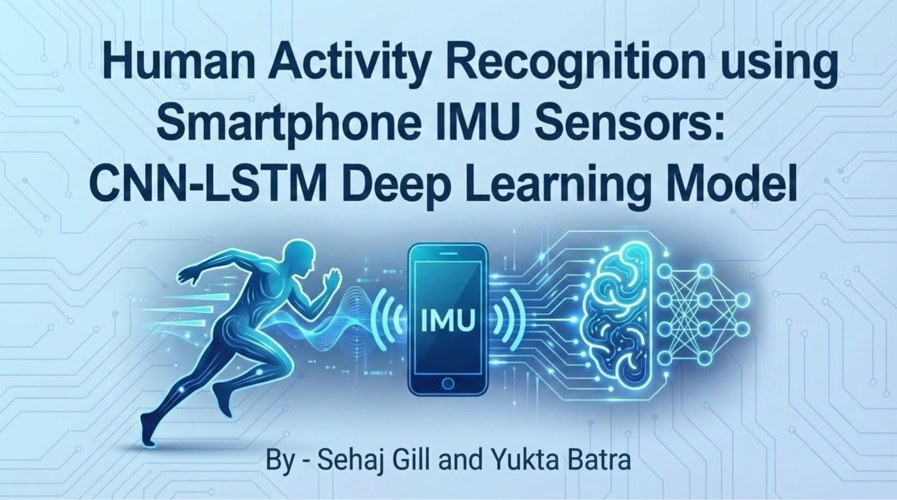
Notes:
Good evening everyone. I’m Yukta, and this is my teammate Sehaj. Today we’re presenting our project on Human Activity Recognition using smartphone IMU sensors.
We built a complete end-to-end pipeline, starting from raw sensor logs recorded on our phones and ending with a deep learning model — a CNN-LSTM network — that can recognize human activities with very high accuracy.

Slide 2
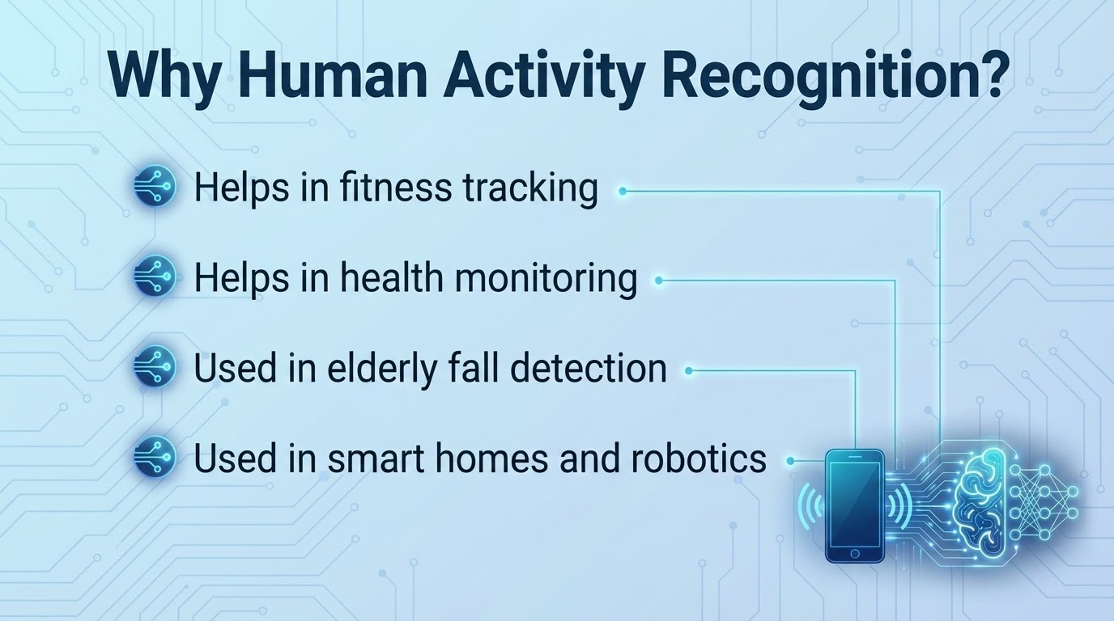
Notes:
Our goal was to design a HAR system that works using nothing but a regular smartphone’s sensors.”
the idea behind this project comes from a simple observation. Modern smartphones already contain high-quality sensors like accelerometers, gyroscopes, and orientation sensors. These sensors constantly capture patterns in the way our bodies move throughout the day. If we process those signals properly, we can classify activities very accurately.
This has useful applications in fitness tracking, posture monitoring, healthcare, fall detection for elderly individuals, and many areas of human-computer interaction. So we wanted to explore how well smartphone IMU data can be used to automatically identify different activities.

Slide 3
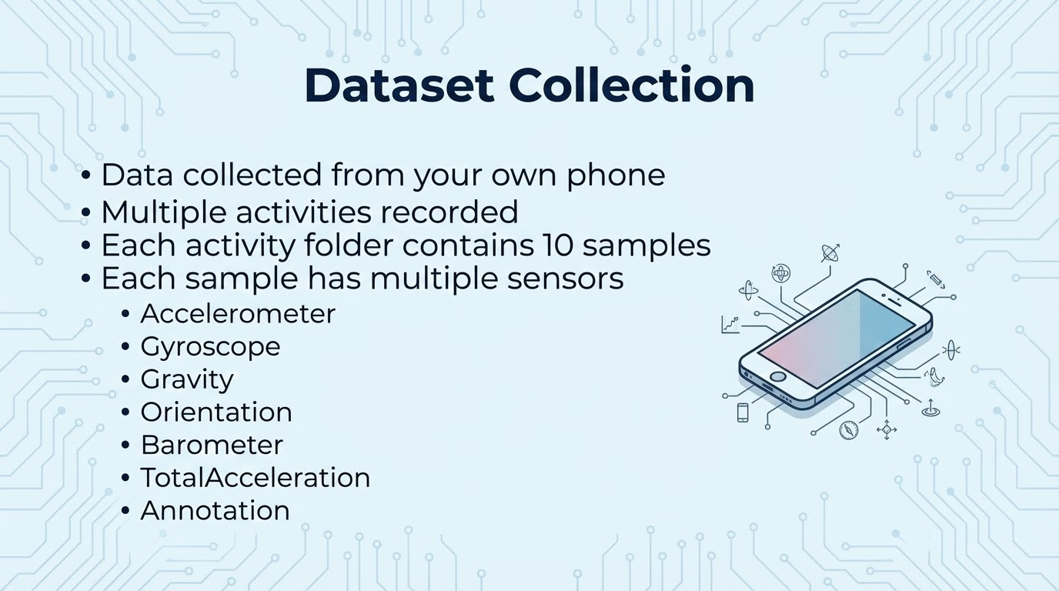
Notes:
To build our dataset, we recorded 14 different activities. These included exercises like biceps curls, jumping, lunges, squats, as well as motions like walking, running, cycling, sitting, standing, and elevator movement.
For each activity, we collected multiple samples. In every sample, the phone generated separate log files for each sensor — the accelerometer, gyroscope, gravity sensor, uncalibrated accelerometer, orientation, and barometer. This produced a rich multivariate time-series dataset that represents both fine-grained motion and broader movement trends

Slide 4
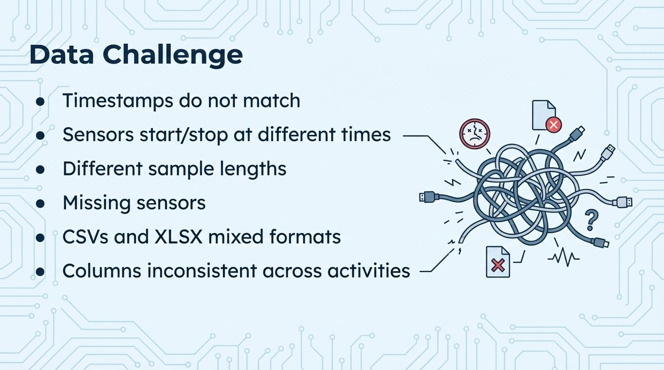
Notes:
Of course, raw sensor data comes with challenges. Each sensor logs at its own frequency, so the sampling rates are different. Their timestamps don’t line up perfectly, and sometimes we have missing readings.
There’s also a lot of inconsistency in file formats and column names. And for deep learning, we need every sample to end up with the same number of features arranged in the same structure. So before even thinking about the model, we had to build a strong preprocessing workflow.

Slide 5
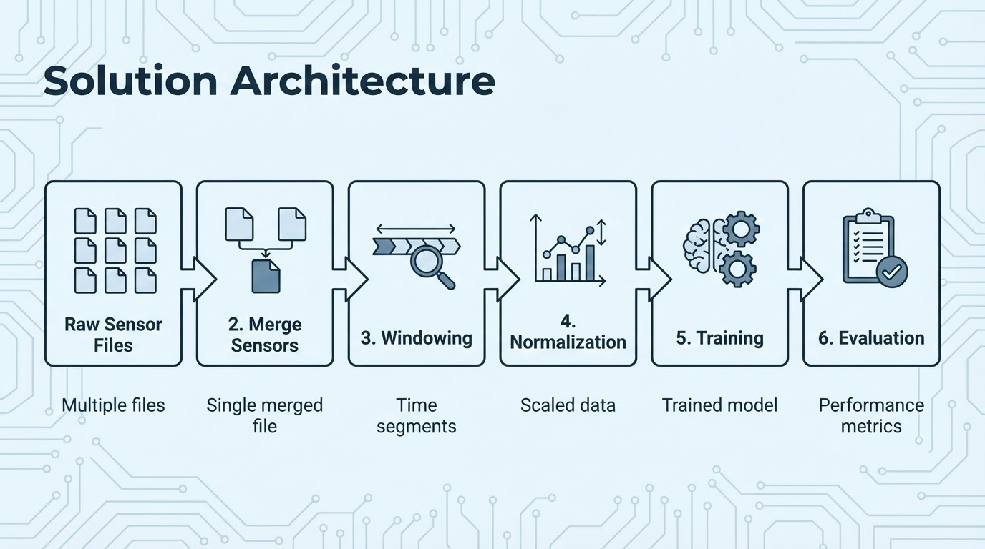
Notes:
To solve these challenges, we designed a complete processing pipeline:
Read all raw sensor files
Merge all sensors into one aligned file
Convert long time-series into fixed windows
Normalize values
Train CNN-LSTM
Evaluate the model
This pipeline allowed us to convert messy phone sensor data into a clean deep-learning-ready dataset

Slide 6
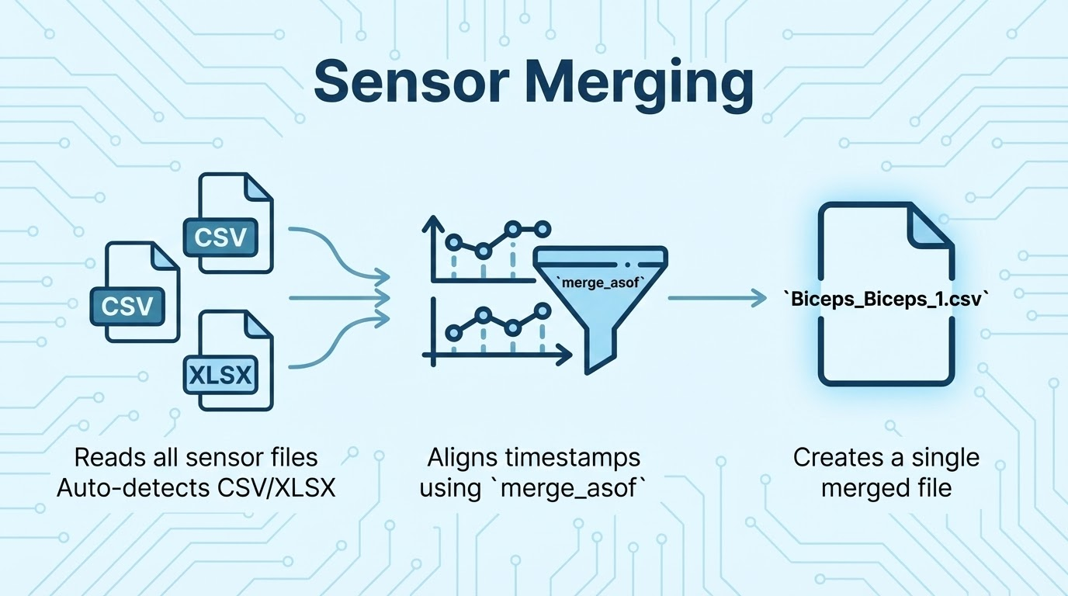
Notes:
To handle all of this, we designed a structured preprocessing pipeline.
The first step was merging all sensors together. We aligned timestamps using merge_asof, which lets us match the closest readings even if the sensors aren’t perfectly synchronized.
After the merge, we ensured every sample had the exact same set of features — twenty-six in total — and filled in any missing values.
We then segmented the data into sliding windows and normalized every feature so that the model receives clean, consistent input.
All these steps were implemented in Python modules to keep the workflow systematic and repeatable

Slide 7
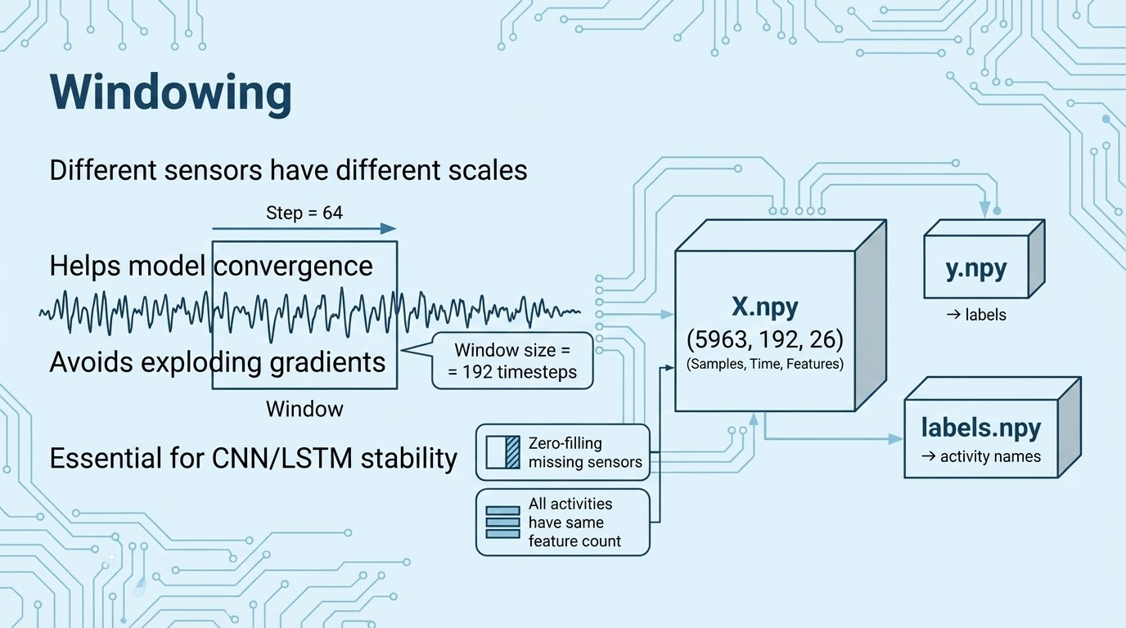
Notes:
For segmentation, we used a window size of 192 samples with a step size of 64. This means each long activity recording is broken into shorter overlapping windows.
This fixed-shape representation is crucial because deep neural networks expect consistent input sizes.
Windowing also expands the dataset, giving the model more examples of the same activity from slightly different contexts

Slide 8
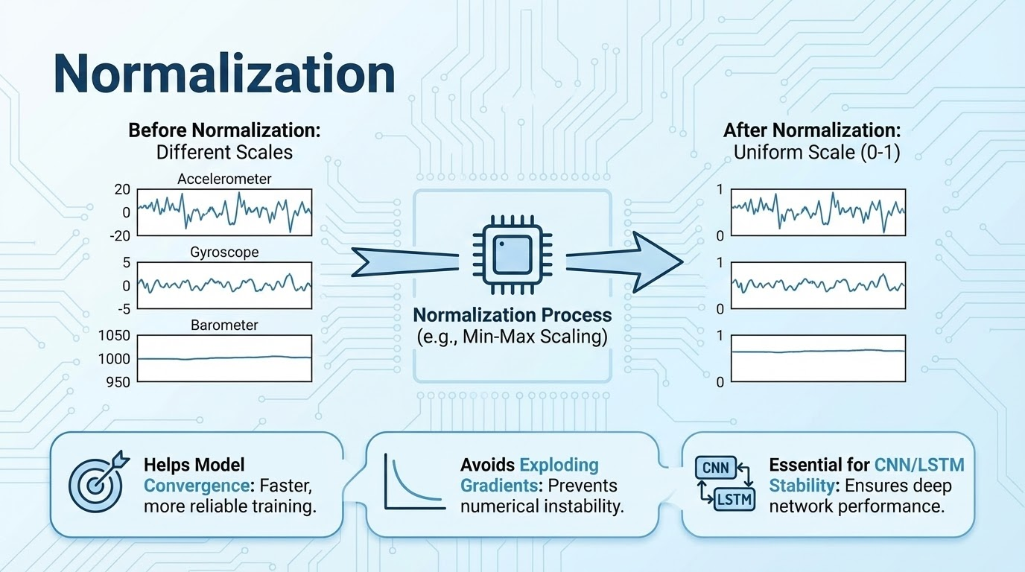
Notes:
Each sensor has different ranges: Accelerometer values might be between -20 to +20. Barometer values are around 900–1000. Gyroscope is completely different.
If we train without normalization, the model becomes unstable. So we used Min-Max scaling to convert every column to 0–1 range. This helps with fast and stable convergence.
That completes the data pipeline.
Now Sehaj will take over to explain our CNN-LSTM model and the training results.

Slide 9
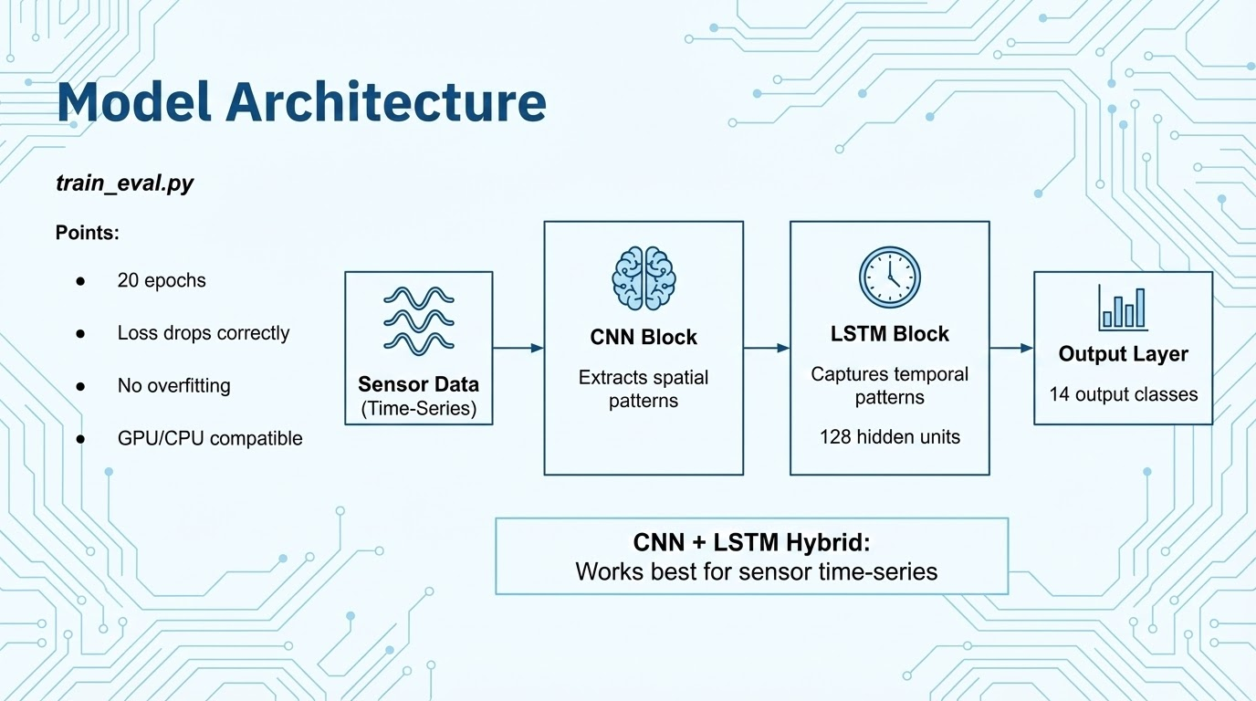
Notes:
Thankyou Yukta .. At this point, once the data was cleaned, aligned, windowed, and normalized, we passed everything into our deep learning model.
We used a hybrid CNN-LSTM architecture. The CNN layers learn short-term temporal patterns — for example, the sharp spike during a jump or the periodic pattern of running.
The LSTM layer focuses on longer sequences of movement and understands how a motion evolves over time.
This combination is extremely effective for IMU-based activity recognition.”

Slide 10
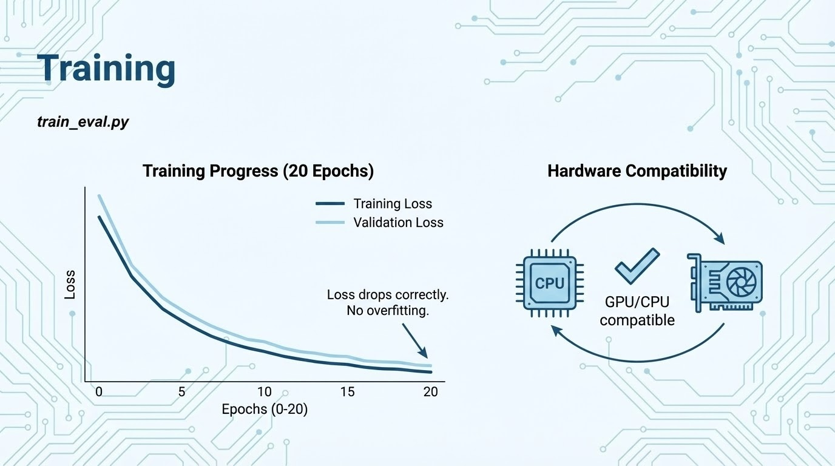
Notes:
Once the model was ready, we trained it using our processed dataset of almost six thousand windows.
We trained for twenty epochs using the Adam optimizer and cross-entropy loss.
The dataset was split into eighty percent training and twenty percent testing.
Even though the training was done on CPU, it remained stable because the preprocessing created uniform, well-scaled input for the model.”
Here you can see the training curve. The loss consistently decreases across all twenty epochs.
There’s no major divergence or sudden spikes, which tells us that the CNN-LSTM architecture — combined with the windowing and normalization — learns the patterns smoothly and doesn’t overfit to the training data.

Slide 11
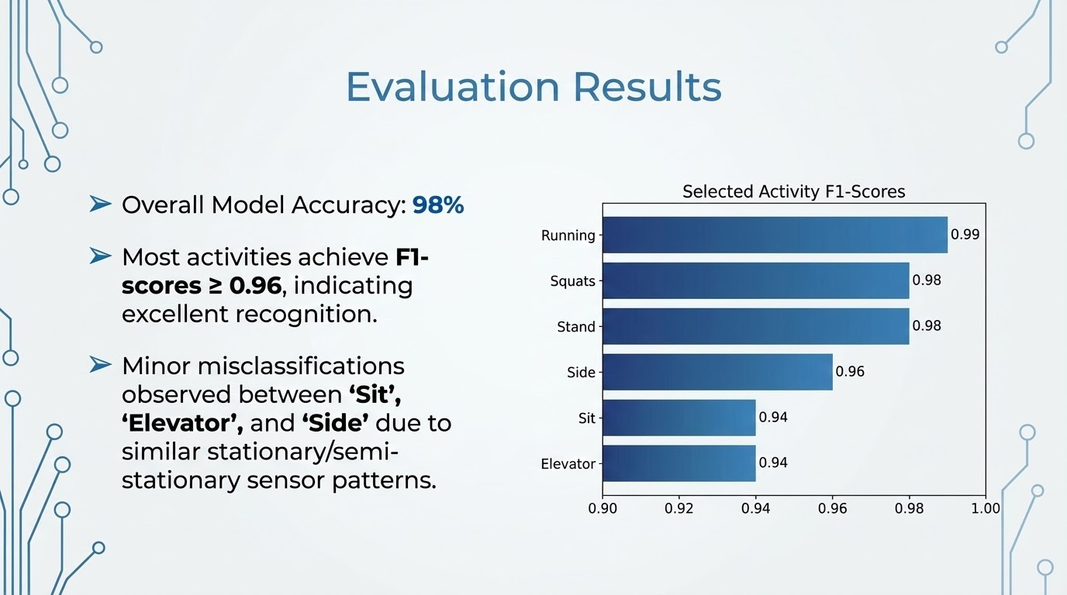
Notes:
When we evaluated the model, we reached an accuracy of about ninety-seven percent.
Most classes had F1-scores above zero-point-nine-five, which shows that the model performs exceptionally well across a wide range of activities.
Given that this dataset was collected manually and contains real-world noise, this level of performance is very strong

Slide 12
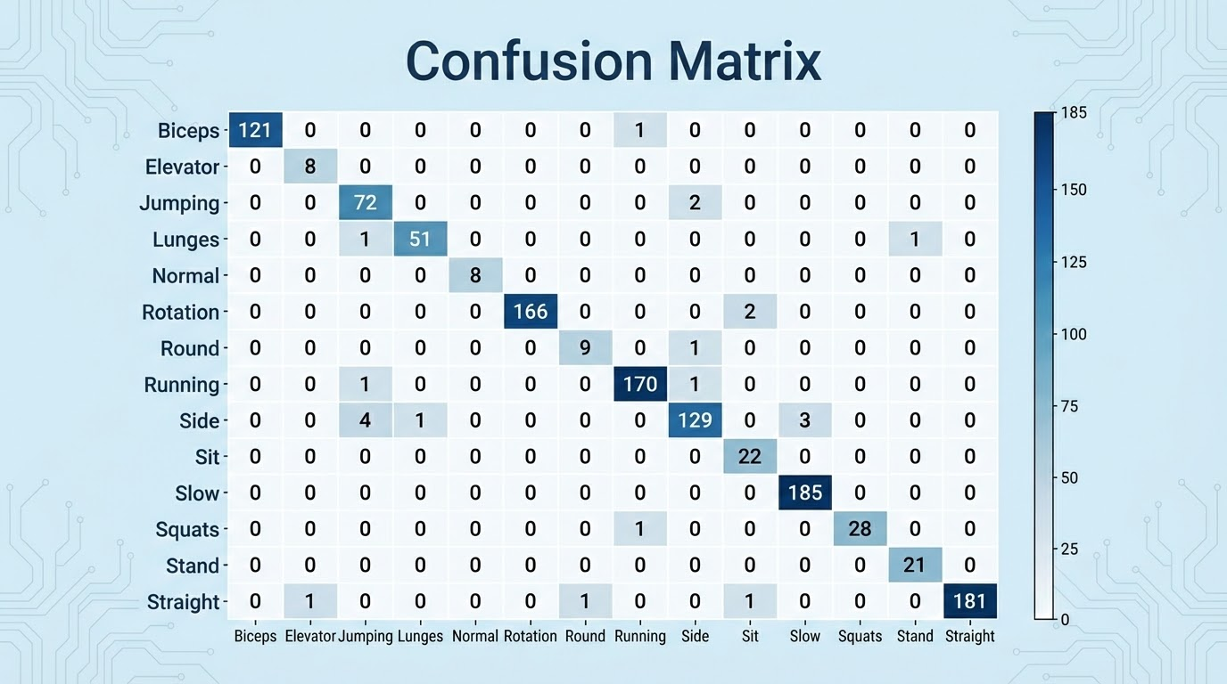
Confusion Matrix
Confusion Matrix:
[[121 0 0 0 0 0 0 1 0 0 0 0 0 0]
[ 0 8 0 0 0 0 0 0 0 0 0 0 0 0]
[ 0 0 72 0 0 0 0 0 2 0 0 0 0 0]
[ 0 0 1 51 0 0 0 0 0 0 0 0 1 0]
[ 0 0 0 0 8 0 0 0 0 0 0 0 0 0]
[ 0 0 0 0 0 166 0 0 0 2 0 0 0 0]
[ 0 0 0 0 0 0 9 0 1 0 0 0 0 0]
[ 0 0 1 0 0 0 0 170 1 0 0 0 0 0]
[ 0 0 4 1 0 0 0 0 129 0 3 0 0 0]
[ 0 0 0 0 0 0 0 0 0 22 0 0 0 0]
[ 0 0 0 0 0 0 0 0 0 0 185 0 0 0]
[ 0 0 0 0 0 0 0 1 0 0 0 28 0 0]
[ 0 0 0 0 0 0 0 0 0 0 0 0 21 0]
[ 0 1 0 0 0 0 1 0 0 1 0 0 0 181]]
Notes:
The confusion matrix gives a clearer picture of how the model performs.
Most predictions fall exactly on the diagonal, which means the model correctly classifies the majority of activities.
Some minor confusion happens in closely related motion patterns — for example, standing versus sitting, or a stationary posture during elevator movement — but overall, the model distinguishes activities extremely well.

Slide 13
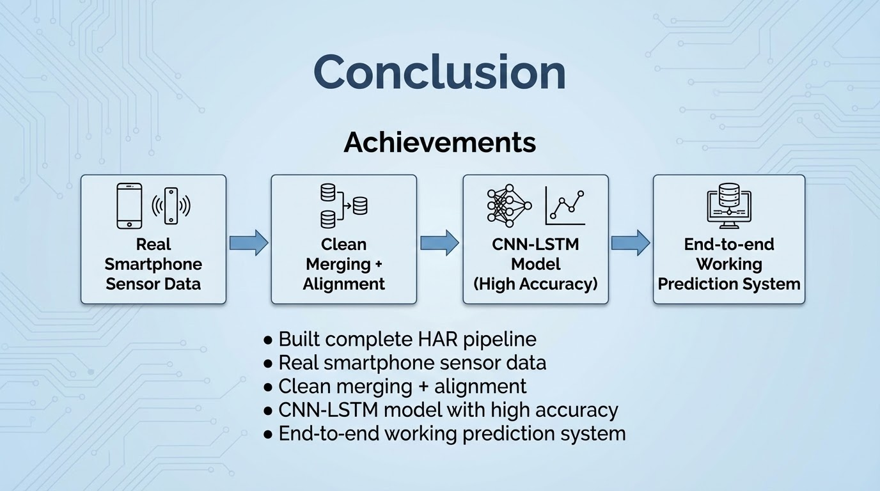
Notes:
For the demo, I’ll walk through the project folder structure to show the raw sensor data, merged files, windowed NumPy arrays, and final model.
I’ll show how the windowing script processes the data, what the shapes of X and y look like, and then I’ll run the training and evaluation script live so you can see the full results printed out — including the classification report and the confusion matrix.
There’s also a real-time prediction version of the pipeline that takes a new IMU CSV and outputs a predicted activity, but we’re not running it live today due to environment constraints
To conclude, we built a complete Human Activity Recognition system from scratch using only smartphone IMU sensors.
We developed a reliable merging and preprocessing pipeline, used windowing to standardize the data, trained a CNN-LSTM model, and achieved strong accuracy.
This approach can be deployed on mobile devices, IoT systems, or health-tracking applications

Slide 14
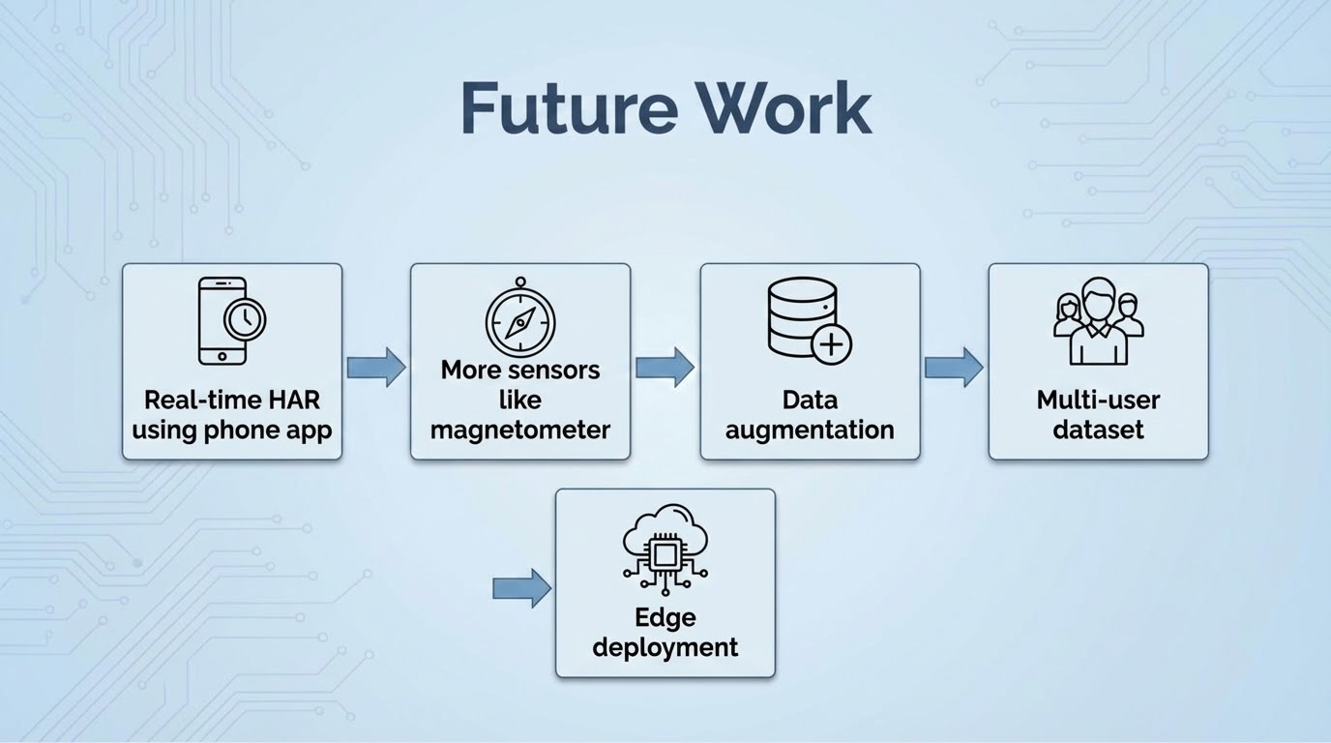
Notes:
In future work, we plan to extend this into a real-time Android app, collect multi-user datasets to improve generalization, explore sensor fusion with additional signals, and experiment with more advanced model architectures.
There’s a lot of potential for applying this system in practical daily-life scenarios.

Slide 15
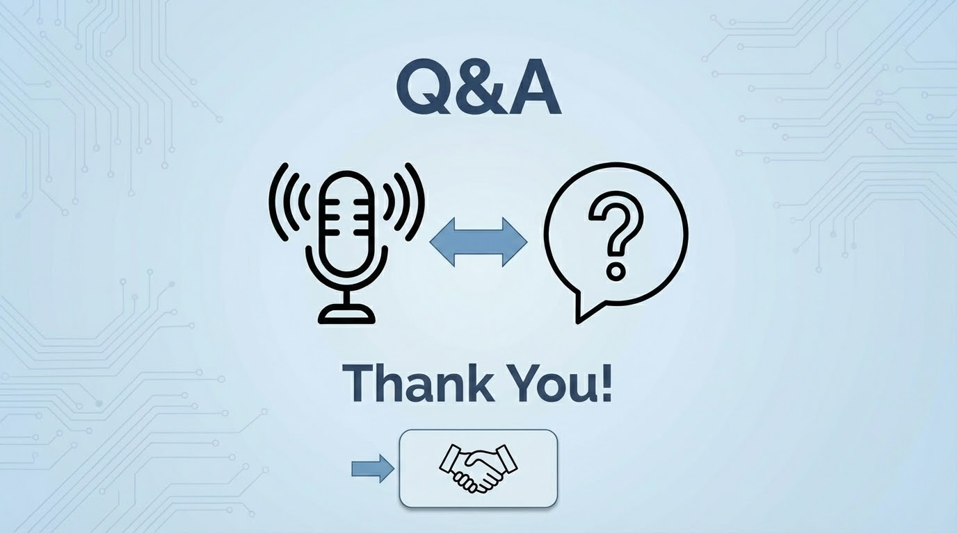
Notes:
Thank you. We’d be happy to take your questions

